Slide 1
How to schedule and monitor COUNTER SUSHI harvesting
Yoel Kortick
Senior Librarian

Slide 2
Table of Contents
Introduction
Step 1: Define the frequency of the SUSHI harvesting
Step 2: Monitor the SUSHI harvesting job reports
Step 3: Monitor the harvested (uploaded from the vendor) files
Step 4: Monitor the harvesting for a specific vendor

Slide 3
Introduction

Slide 4
Introduction
The harvesting of COUNTER reports via SUSHI (Standardized Usage Statistics Harvesting Initiative) can be scheduled by the institution.
In addition, the institution can monitor the harvesting (loading to Alma from the vendor) within Alma.
We will explain here how this can be done.

Slide 5
Step One – Define the frequency of the SUSHI harvesting

Slide 6
Step 1: Define the frequency of the SUSHI harvesting
At “Configuration menu -> Acquisitions -> General -> Acquisition Jobs Configuration” define the frequency in which you want the SUSHI Harvesting job to run.
Here the job is defined to run every Saturday at 08:00

Slide 7
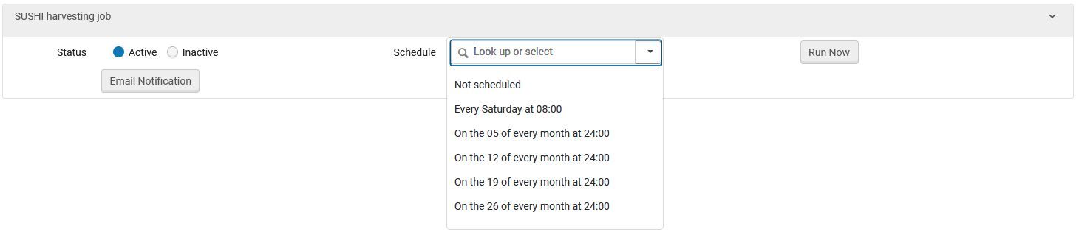
Step 1: Define the frequency of the SUSHI harvesting
Several other scheduling options could also have been chosen

Slide 8
Step Two – Monitor the SUSHI harvesting

Slide 9
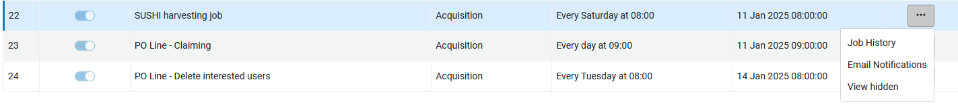
Step 2: Monitor the SUSHI harvesting job reports
Monitor the SUSHI harvesting job reports.
It is possible for the staff when the job runs.
This can be configured via the “row actions” (three dots) at “Alma Menu > Admin > Manage Jobs and Sets > Monitor Jobs > Go to “Scheduled” Tab > Filter by “Acquisitions”
On the line for “SUSHI harvesting job” access the “row actions” and choose “Email Notifications”

Slide 10
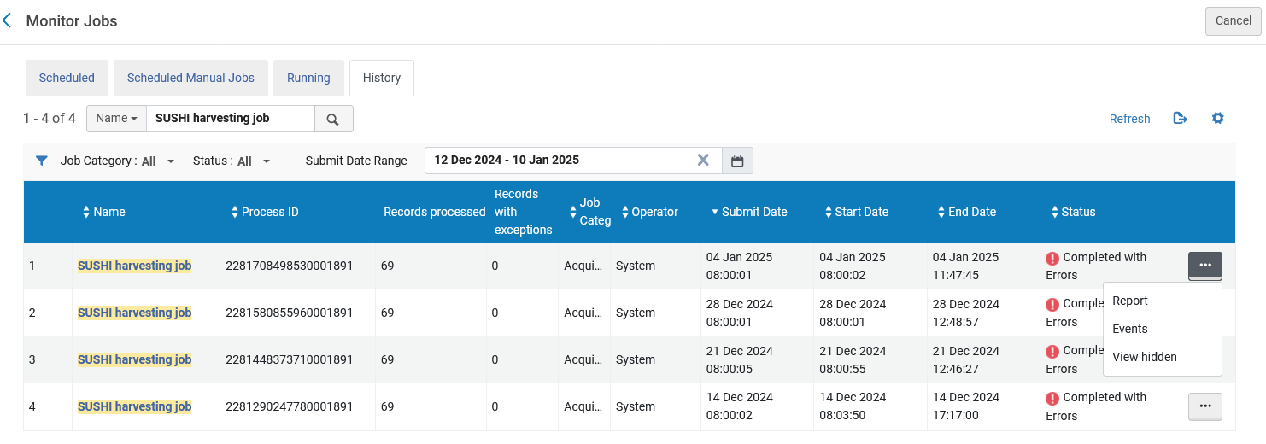
Step 2: Monitor the SUSHI harvesting job reports
The “SUSHI harvesting job” report can be viewed at “Monitor Jobs > History tab”

Slide 11
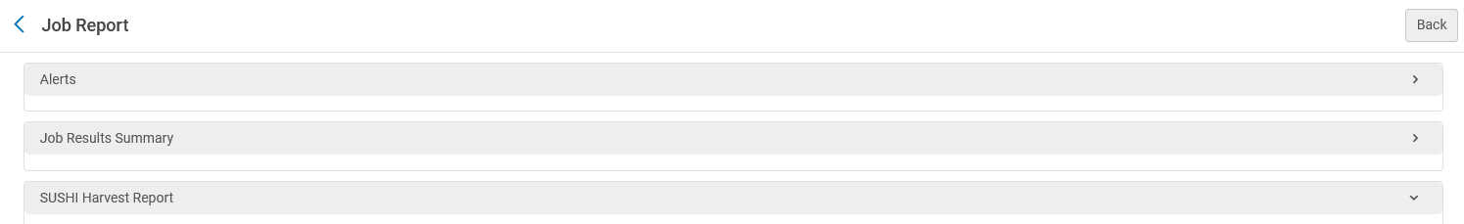
Step Two
The report contains three sections:
Alerts
Job Results Summary
SUSHI Harvest Report

Slide 12
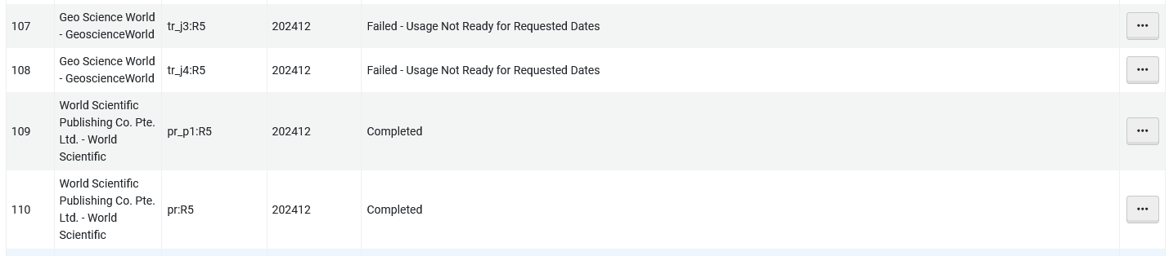
Step 2: Monitor the SUSHI harvesting job reports
Here is (part of) the SUSHI Harvest Report
These two failed. This message is an error provided by the vendor, as defined by Project COUNTER. You can see the specific error definitions at Appendix F: Handling Errors and Exceptions (part of the official COUNTER site).
These two completed successfully.

Slide 13
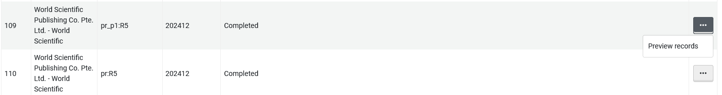
Step 2: Monitor the SUSHI harvesting job reports
Each row can be further investigated

Slide 14
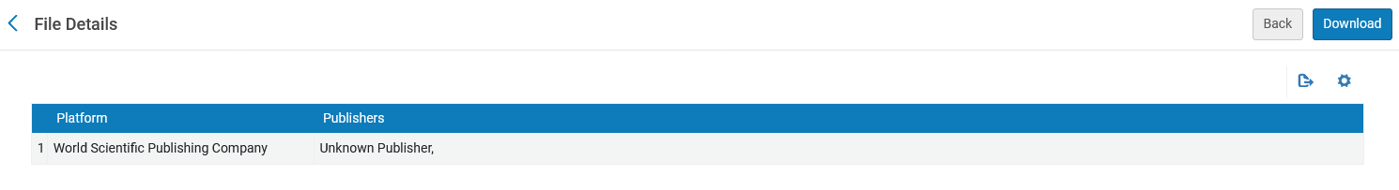
Step 2: Monitor the SUSHI harvesting job reports
After clicking “Preview records’ for a specific row it is possible to download the loaded COUNTER report.

Slide 15
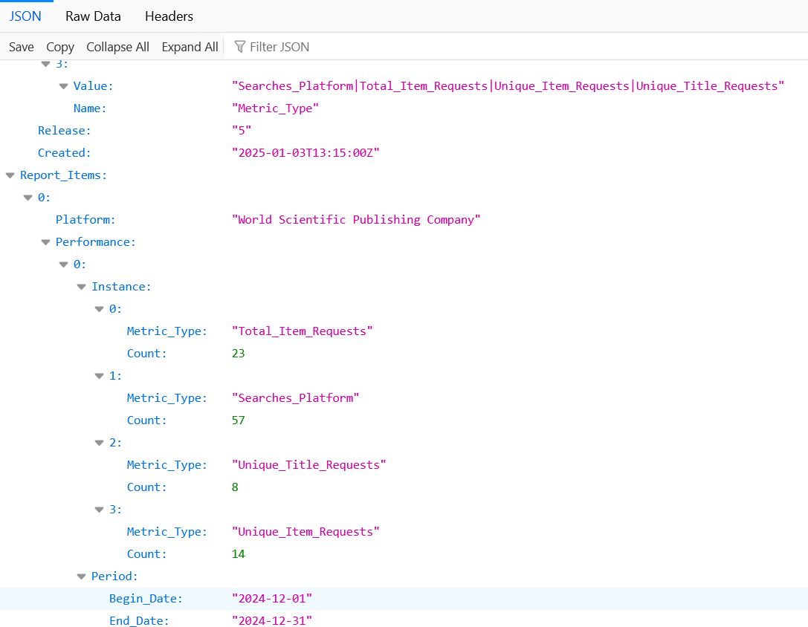
Step 2: Monitor the SUSHI harvesting job reports
Here is (part of) the downloaded COUNTER report.
Usage Measures
Usage Time period

Slide 16
Step Three - Monitor the harvested (uploaded from the vendor) files

Slide 17
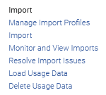
Step 3: Monitor the harvested (uploaded from the vendor) files
It is possible to monitor the files which have been uploaded via the “Usage Data Loader” page.
The “Usage Data Loader” page can be accessed at “Alma Menu > Acquisitions > Import > Load Usage Data”

Slide 18
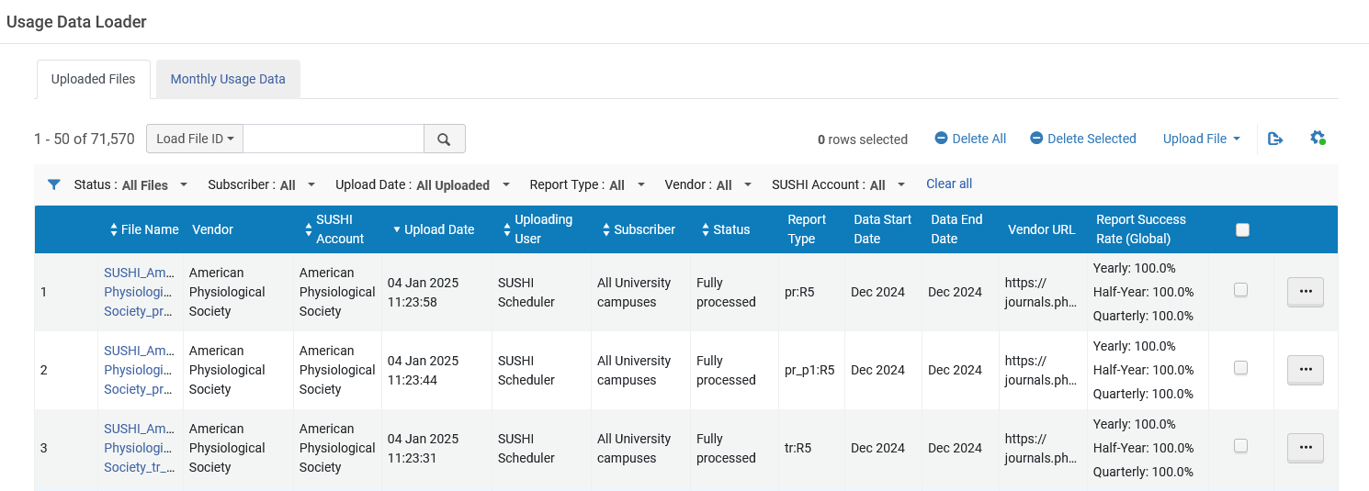
Step 3: Monitor the harvested (uploaded from the vendor) files
The ‘Uploaded files’ tab allows us to view the files which were uploaded and their status along with additional information
Multiple filtering options

Slide 19
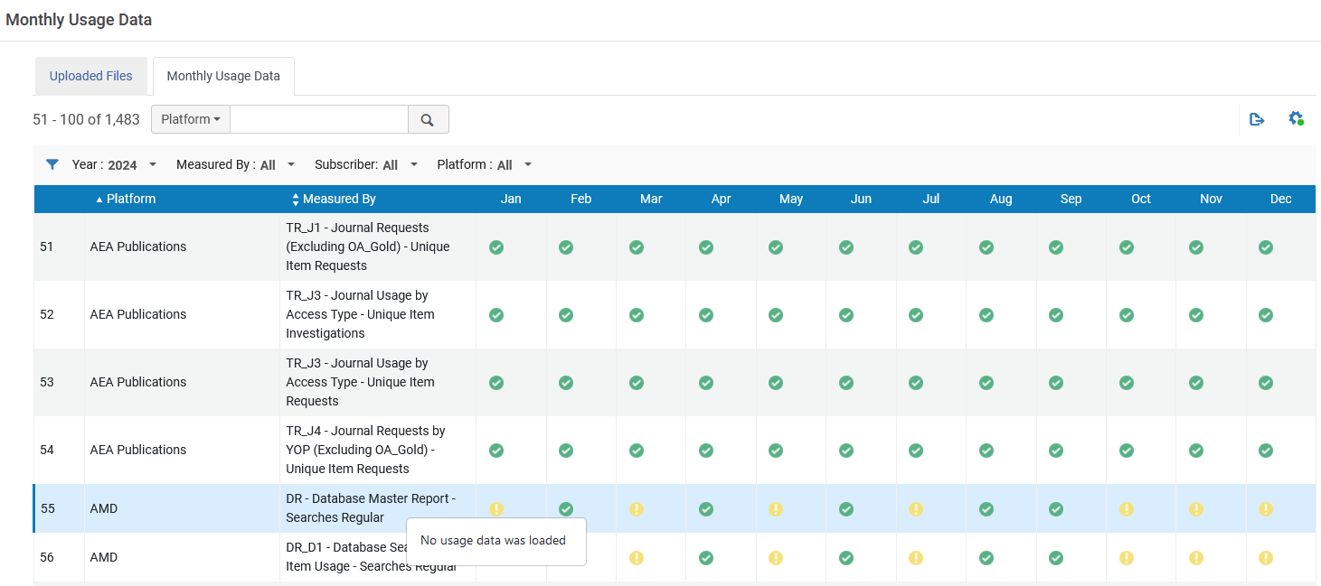
Step 3: Monitor the harvested (uploaded from the vendor) files
The ‘Monthly usage data’ tab allows the user to view the SUSHI status by platform
The green check mark means that the usage report was successfully retrieved and loaded
The yellow exclamation mark means that no usage data was loaded

Slide 20
Step Four - Monitor the harvesting for a specific vendor

Slide 21
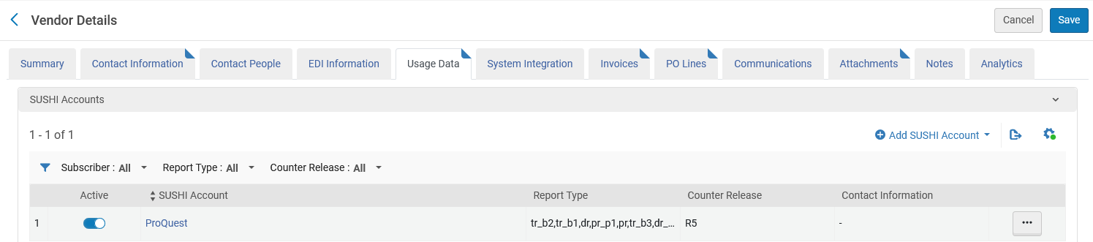
Step 4: Monitor the harvesting for a specific vendor
In the “Usage Data” tab of a specific vendor, when viewing the specific SUSHI accounts, it is possible to see all files which have been harvested for that specific SUSHI account. Here is vendor “ProQuest LLC”
On the next slide we will see that the lower section will include harvesting details for this active SUSHI account

Slide 22
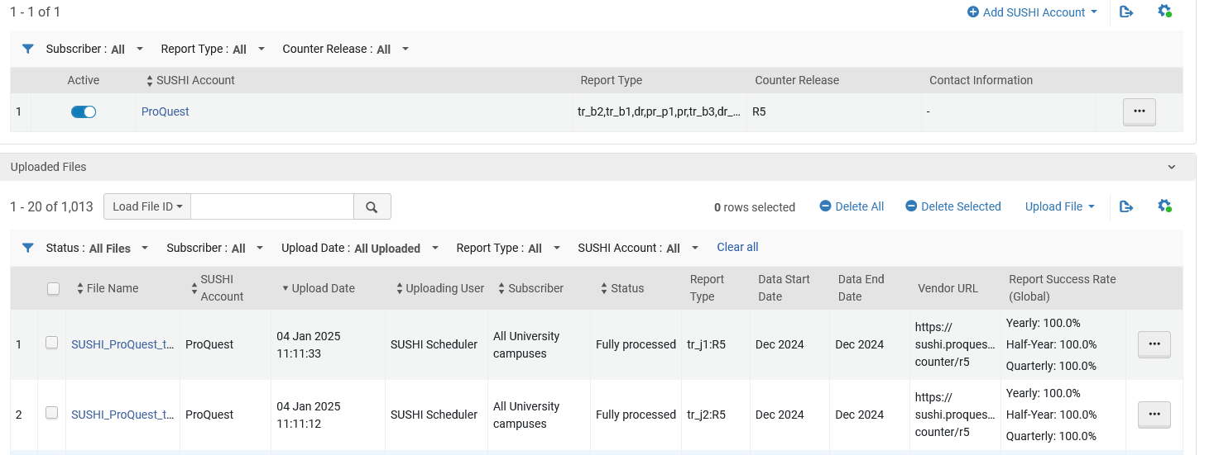
Step 4: Monitor the harvesting for a specific vendor
This is identical to the “Usage data Loader” page seen in step three, but it is already filtered by one particular vendor.
When there are multiple active SUSHI accounts it is possible to filter by a specific one.

